Slide 1




Unleashing Stretched Databases
Armando Lacerda MCT | MCDBA | MCSE | MCSA | MCSD.Net
me@armandolacerda.com
@arlacerda

Slide 2
Thanks to our sponsors

Slide 3

Setup
Historical Data
Backup & restore

Slide 4
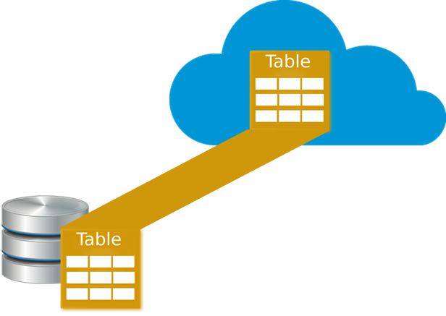
Setup
Historical Data
Backup & restore

Slide 5

Stretched Database - PreReq
Azure Account
Compatible table
Split criteria – Optional
Network bandwidth
Setup
Historical Data
Backup & restore

Slide 6
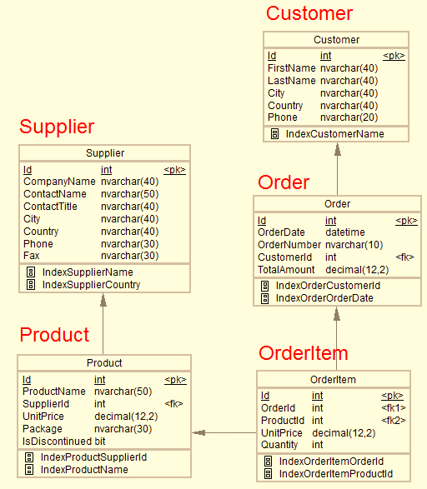
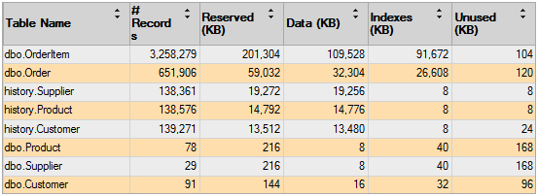
Remote data
Stage Data
Local data
http://www.dofactory.com/sql/sample-database

Slide 7
Remote data
Stage Data
Local data
Demo - Stretched it

Slide 8
Stretched Database
Stage Data
Remote data
Local data

Slide 9
Stretched Database
Stage Data
Remote data
Local data

Slide 10
Stretched Database
Stage Data
Remote data
Local data

Slide 11
Stretched Database
Remote data
Stage Data
Local data
http://www.dofactory.com/sql/sample-database

Slide 12
Benefits
Cost Effective
No database schema change needed
Transparent to applications

Slide 13
Restrictions
Can’t update or delete stretched rows
Views referring to stretched tables have limited features
Can’t be the parent table of a Foreign Key constraint

Slide 14
Blocking Factors
FileStream not allowed
Memory-optimized tables not allowed
Replication, Change Tracking and CDC not allowed
Some special data types not allowed
Column_set and computed columns not allowed
Default, Check and not allowed
Full Text, XML, Spatial and indexed views indexes not allowed
Price

Slide 15

Transactional Database
Demo - Historical data / cold data

Slide 16



Automatic backup
Local replication
Geo replication
Transparent
Backup & Restore
Transactional Database
Traditional SQL Server backup
Fraction of the database
Fraction of backup time

Slide 17
Automatic backup
Local replication
Geo replication
Transparent
Backup & Restore
Transactional Database
Traditional SQL Server backup
Fraction of the database
Fraction of backup time

Slide 18
Backup & Restore
Transactional Database
Automatic backup
Local replication
Geo replication
Transparent
Traditional SQL Server backup
Fraction of the database
Fraction of backup time

Slide 19
Backup & Restore
Transactional Database
Automatic backup
Local replication
Geo replication
Transparent
Traditional SQL Server backup
Fraction of the database
Fraction of backup time

Slide 20
Backup & Restore
Transactional Database
Automatic backup
Local replication
Geo replication
Transparent
Traditional SQL Server backup
Fraction of the database
Fraction of backup time

Slide 21

Demo - Backup & Restore
Transactional Database
Automatic backup
Local replication
Geo replication
Transparent
Traditional SQL Server backup
Fraction of the database
Fraction of backup time

Slide 22
Questions

Slide 23
Thank you!
Some web references: https://msdn.microsoft.com/en-us/library/dn935011.aspx?f=255&MSPPError=-2147217396
https://msdn.microsoft.com/en-us/library/mt605115.aspx?f=255&MSPPError=-2147217396
https://msdn.microsoft.com/en-us/library/mt762899.aspx
https://msdn.microsoft.com/en-us/library/mt733205.aspx

